Slide 1


India All-Star Training: Python – Exception Handling
28.03.2023
Sridhar Mahamkali & Rajesh Shendre

Slide 2
Python – Topics
Exceptions
Exception Handling
Try and Except
Nested try Block
Handling Multiple Exceptions in single Except Block
Raising Exception
User Defined Exceptions
Finally Block

Slide 3
Exceptions
When writing a program, we, more often than not, will encounter errors.
Error caused by not following the proper structure (syntax) of the language is called syntax error or parsing error.
Errors can also occur at runtime, and these are called exceptions.

Slide 4
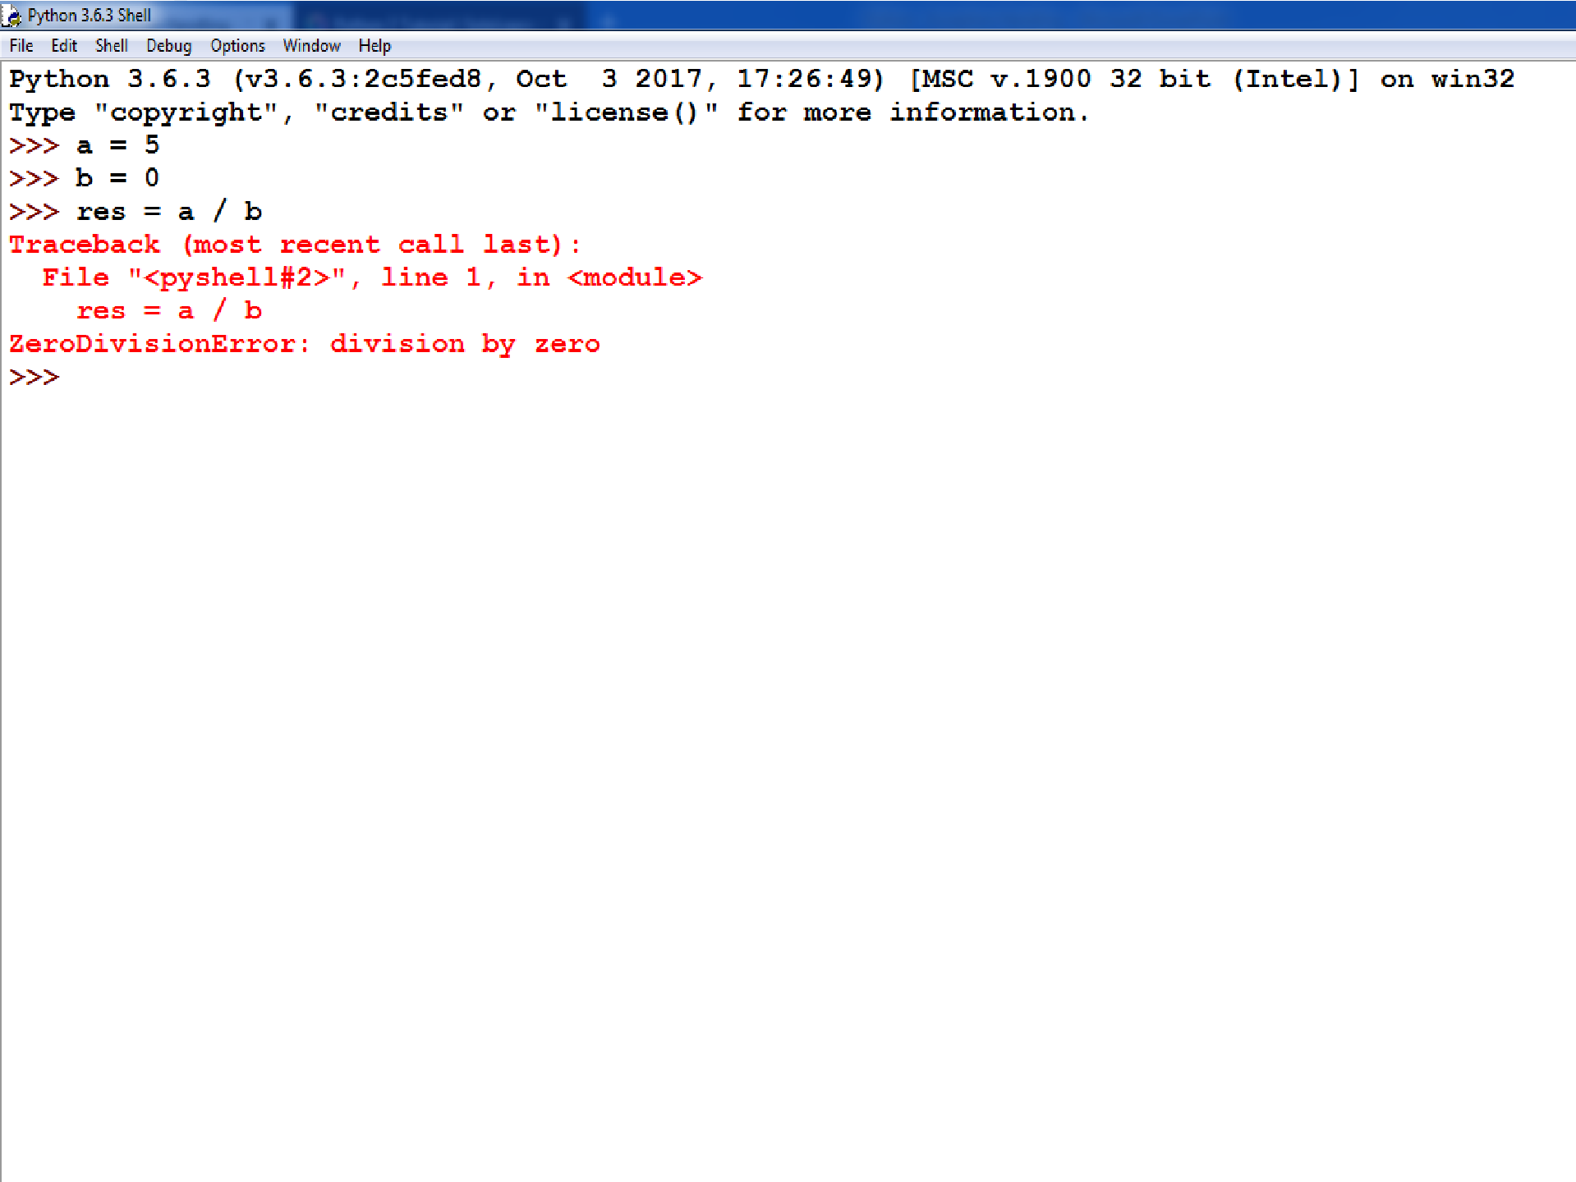

Slide 5
Exception Handling
To handle exceptions, and to call code when an exception occurs, we can use a try/except statement.
The try block contains code that might throw an exception.
If that exception occurs, the code in the try block stops being executed, and the code in the except block is executed.
If no error occurs, the code in the except block doesn't execute.

Slide 6
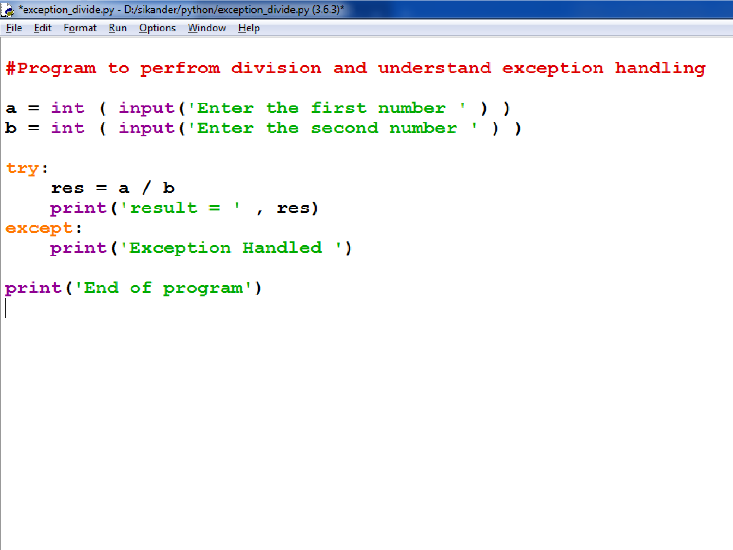

Slide 7
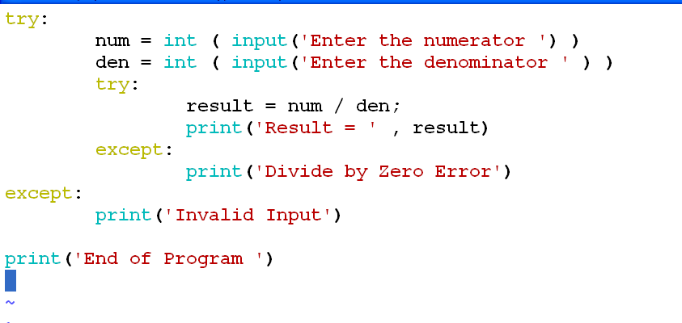
Nested Try Block

Slide 8
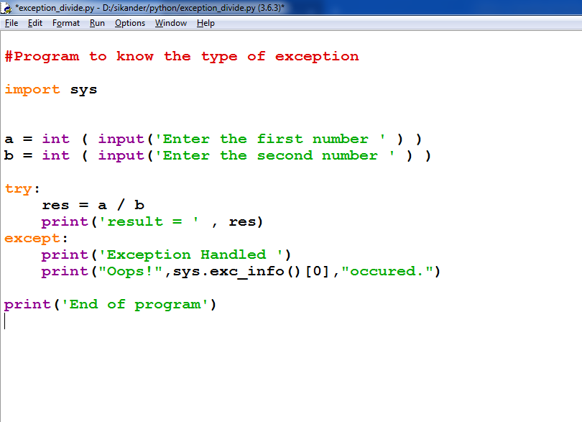

Slide 9
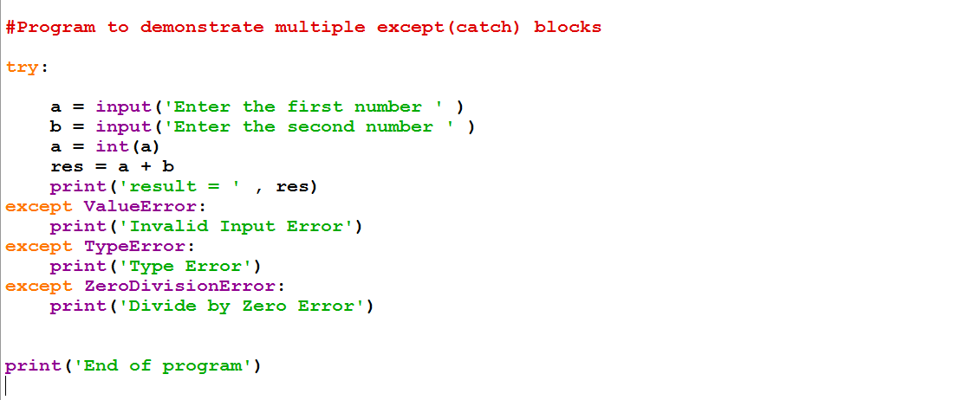
A try statement can have multiple different except blocks to handle different exceptions.

Slide 10
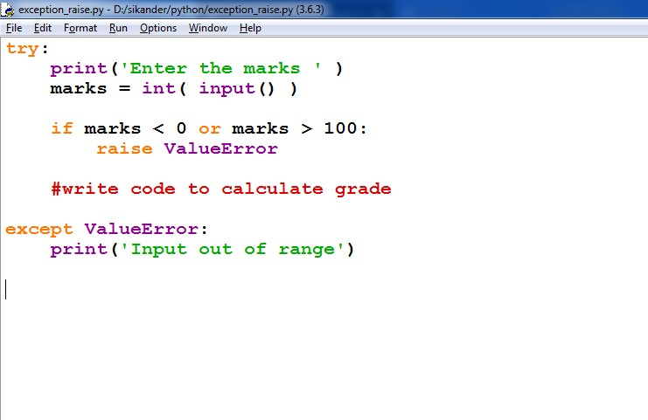
Raising Exception
Raising exception is similar to throwing exception in C++/Java.
You can raise exceptions by using the raise statement

Slide 11
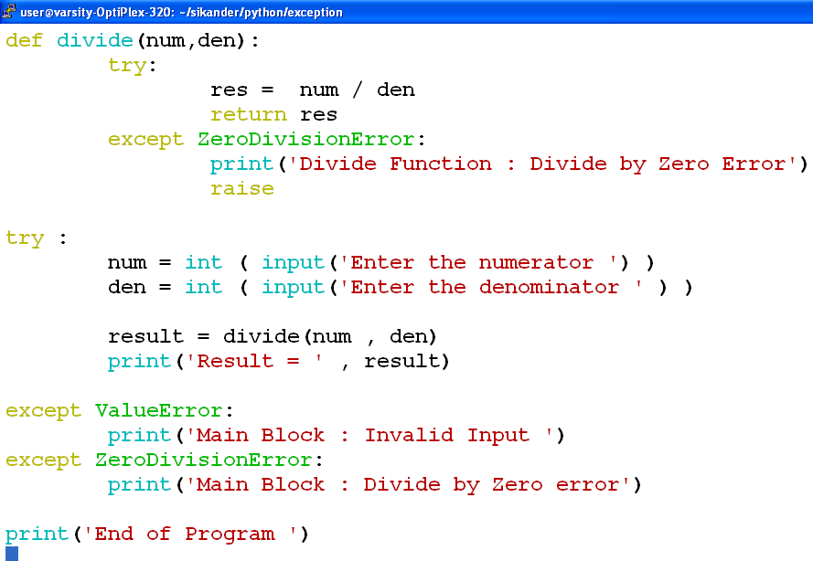
Raising Exception from Except Block

Slide 12
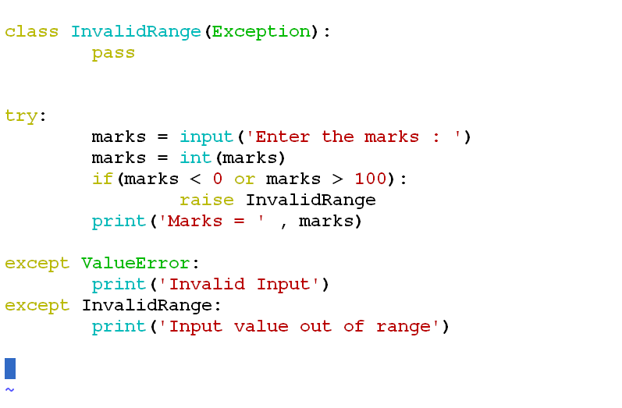
User Defined Exception
user-defined exception is an exception that you define yourself by creating a new class that inherits from the built-in Exception class or one of its subclasses.
This allows you to raise and handle exceptions that are specific to your application or module.

Slide 13
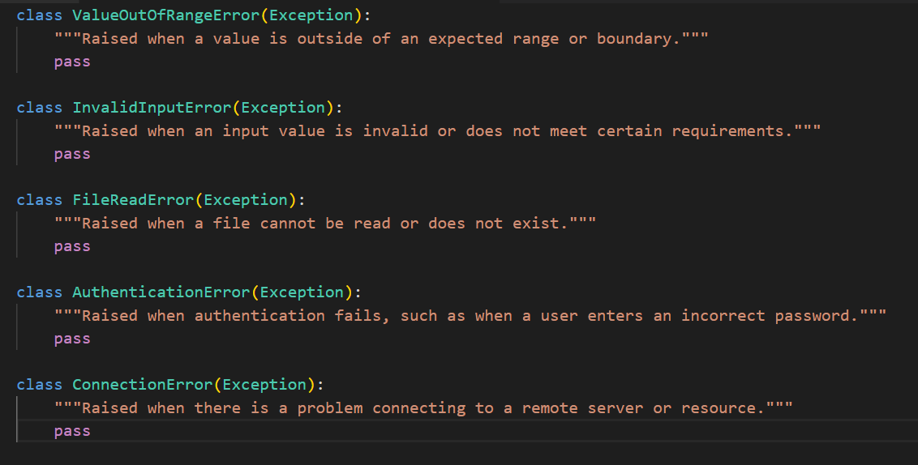
Some Other User Defined Exceptions:

Slide 14
finally
T o ensure some code runs no matter what errors occur, you can use a finally statement.
The finally statement is placed at the bottom of a try/except statement.
Code within a finally statement always runs after execution of the code in the try, and possibly in the except, blocks.

Slide 15
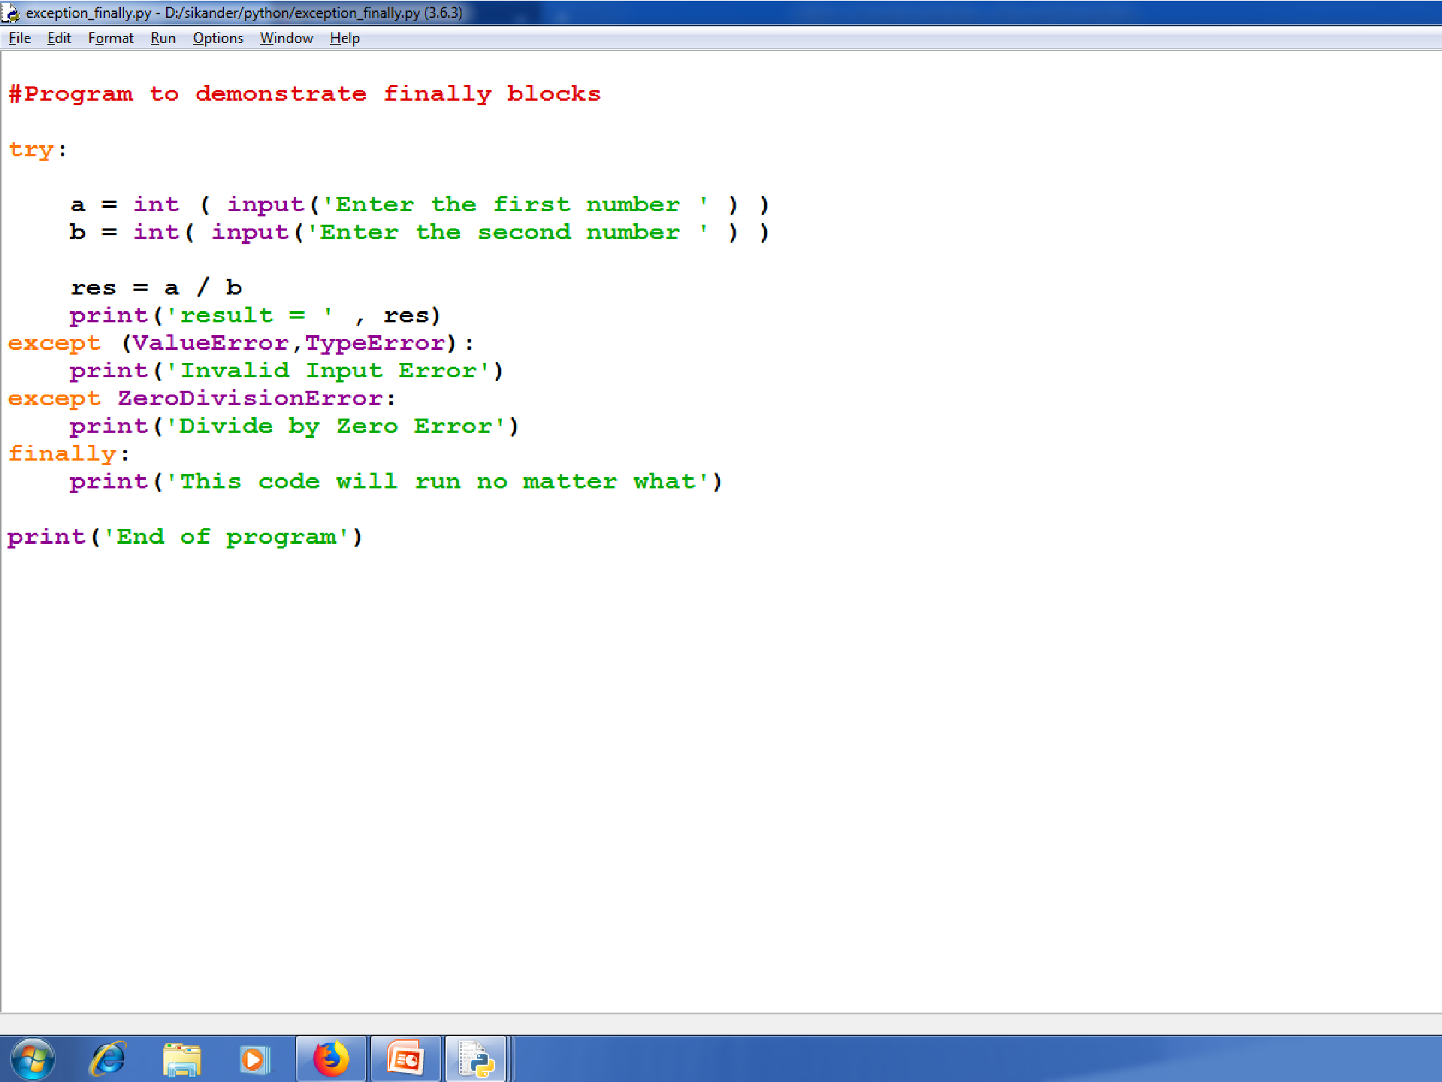

Slide 16
Thank You

